Slide 1
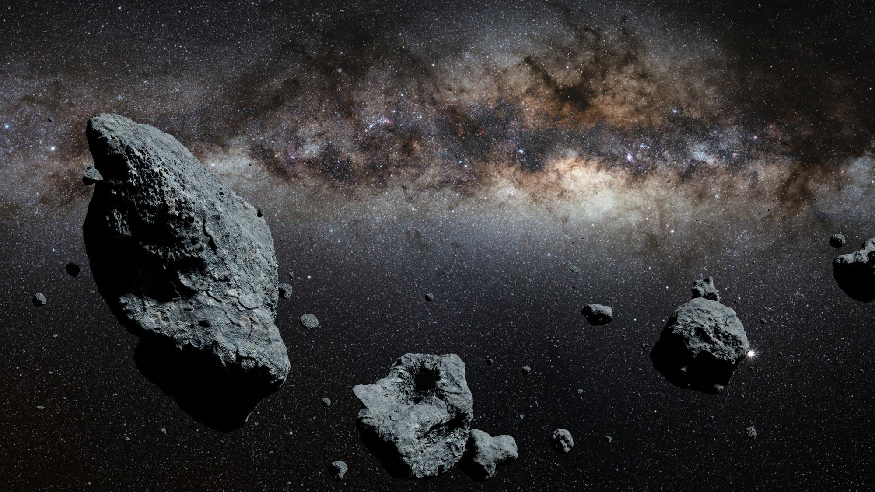



The Effects of Space Weathering on Airless Solar System Bodies
Mitchell Magnuson, Dr. Mark Loeffler
Image credit: Tabitha Watson (2017)

Slide 2
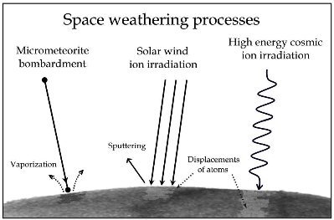
Space Weathering
Space Weathering: Process which changes surface environments in space
Causes
Cosmic rays
Micrometeorites
Solar wind
Important for the evolution of the Solar System
Image credit: Giovanni Strazzulla (INAF)

Slide 3
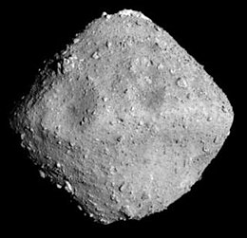
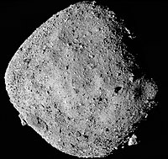
Focus of this research
Carbonaceous [C] Target
  Mimics surface material on C-complex asteroids
San Carlos Olivine [Mg_{1.8}Fe_{0.2}SiO₄] Sample
  A ratio of 90% magnesium and 10% iron typical of asteroid surface compositions
Ryugu (162173)
C-type (C-complex)¹
Bennu (101955)
B-type (C-complex) ²
Image credit: JAXA’s Hayabusa2 Mission
Image credit: NASA’s OSIRIS-REx Mission
References [1] Müller, T. G. et al (2016) Hayabusa-2 Mission Target Asteroid, [2] Clark, B.E., et al., Icarus 216, 462-475 (2011)

Slide 4
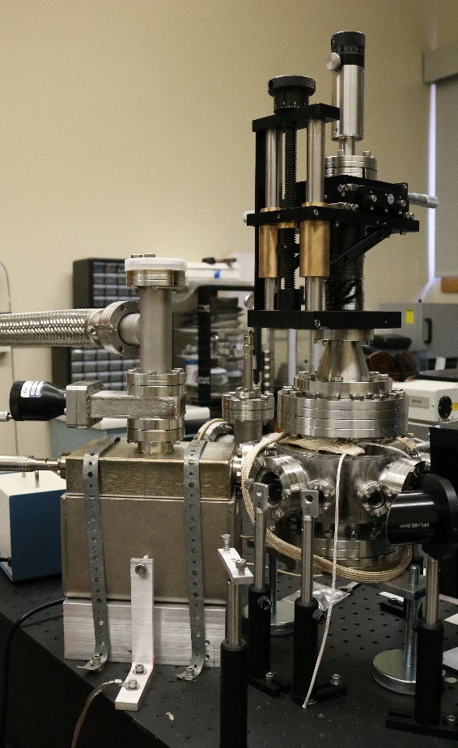
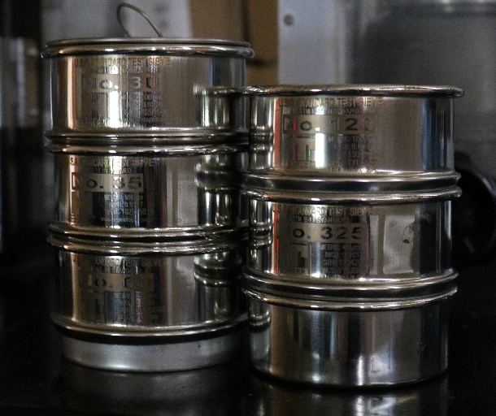
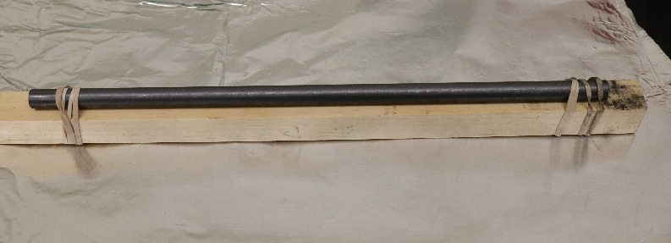
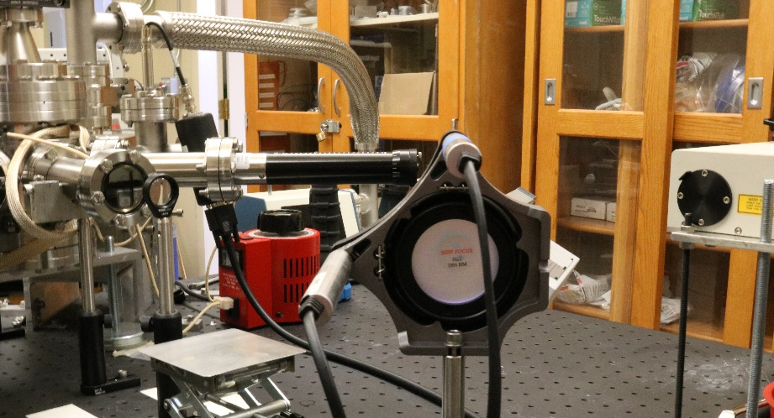
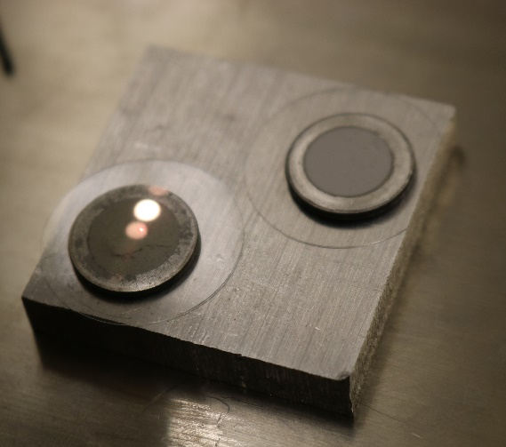
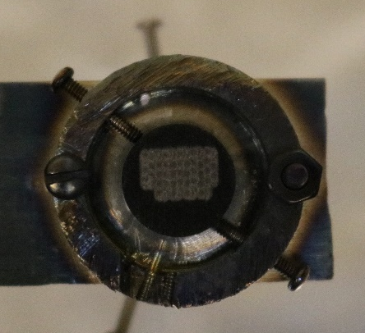
Process
Target and sample creation
2) Evacuating the
system
3) Irradiating the target
4) Analyzing in near-infrared and
ultraviolet

Slide 5
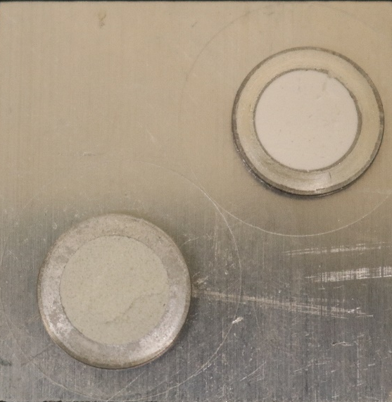
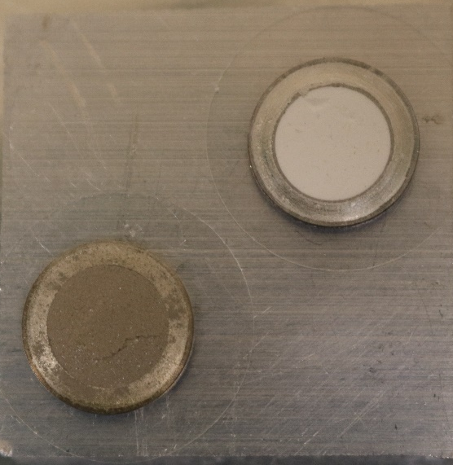
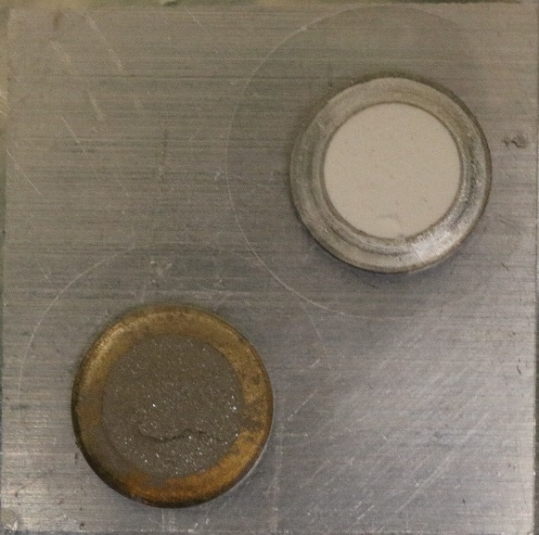
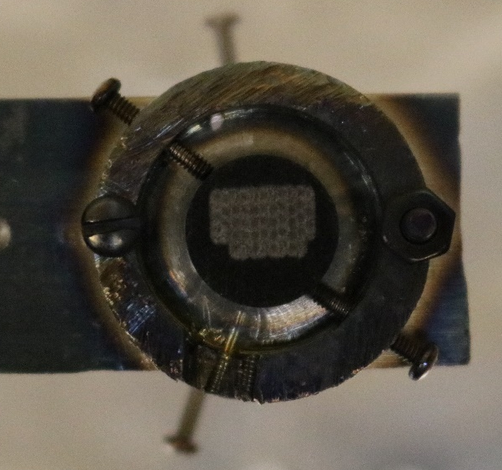
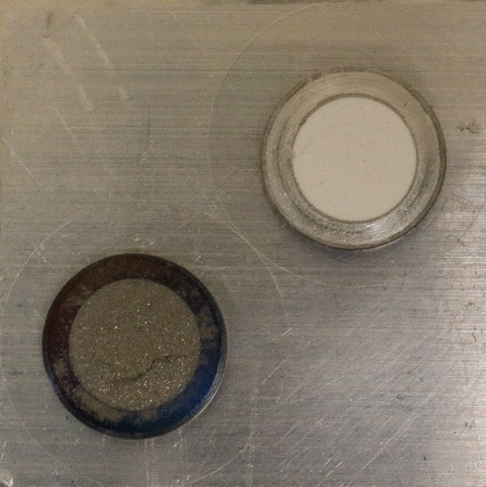
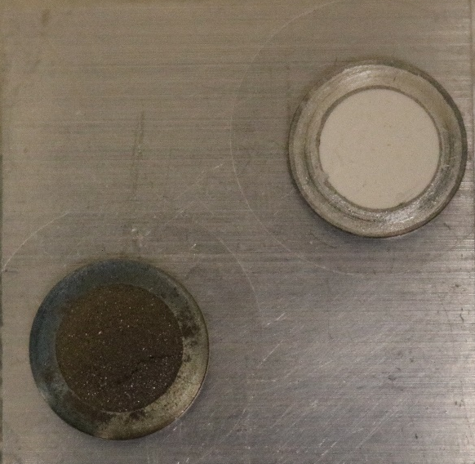
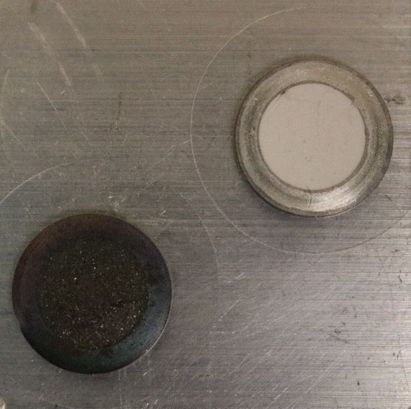
Results
Fresh
4 Shots
8 Shots
Teflon Reference
Graphite Target After 64 Shots of Irradiation
San Carlos Olivine Sample
16 Shots
32 Shots
64 Shots

Slide 6
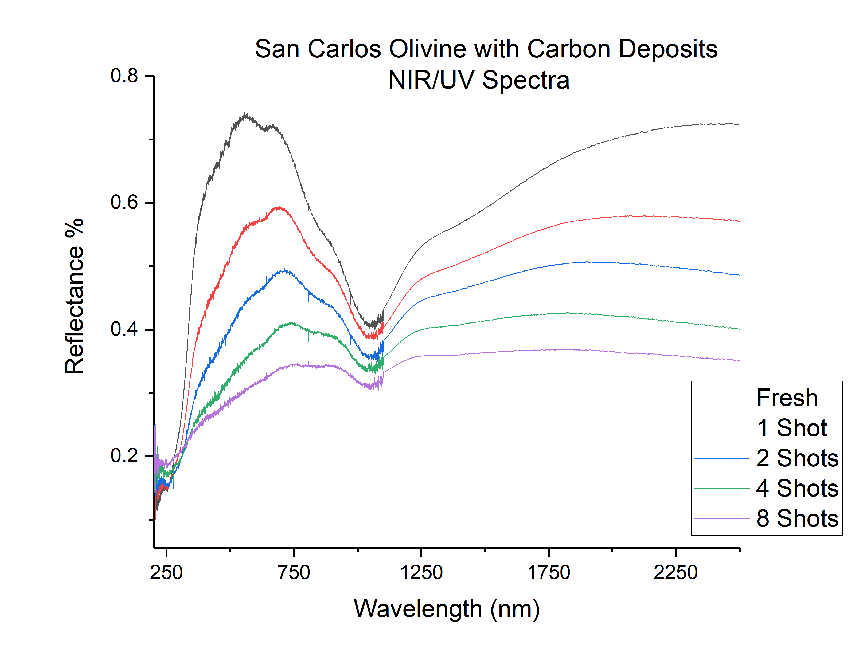

Slide 7
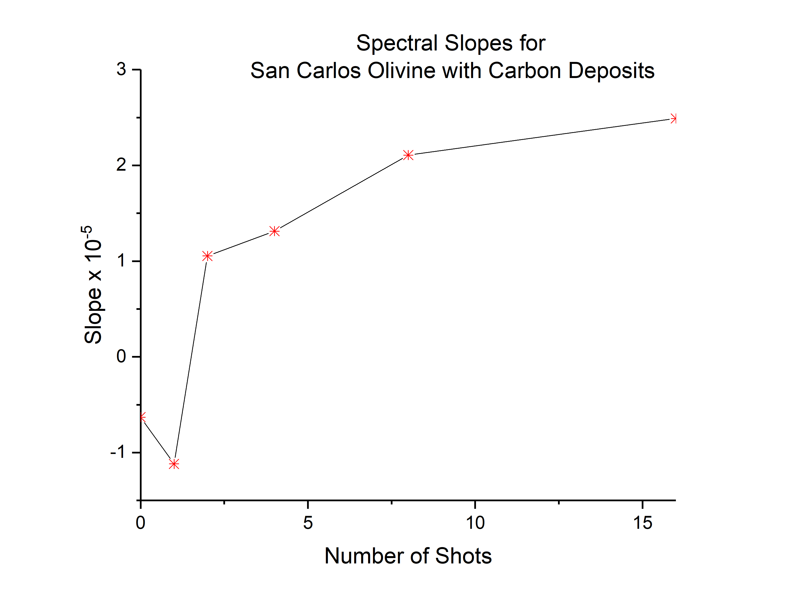
Spectral Reddening
Slight spectral reddening observed between 0.7-2.0 microns
10,000 times less prominent than similar experiments¹.
References: [1] Loeffler, M, et al (2008) Laboratory simulations
of redeposition of impact ejecta on mineral surfaces.
Icarus 196, 285-292.

Slide 8
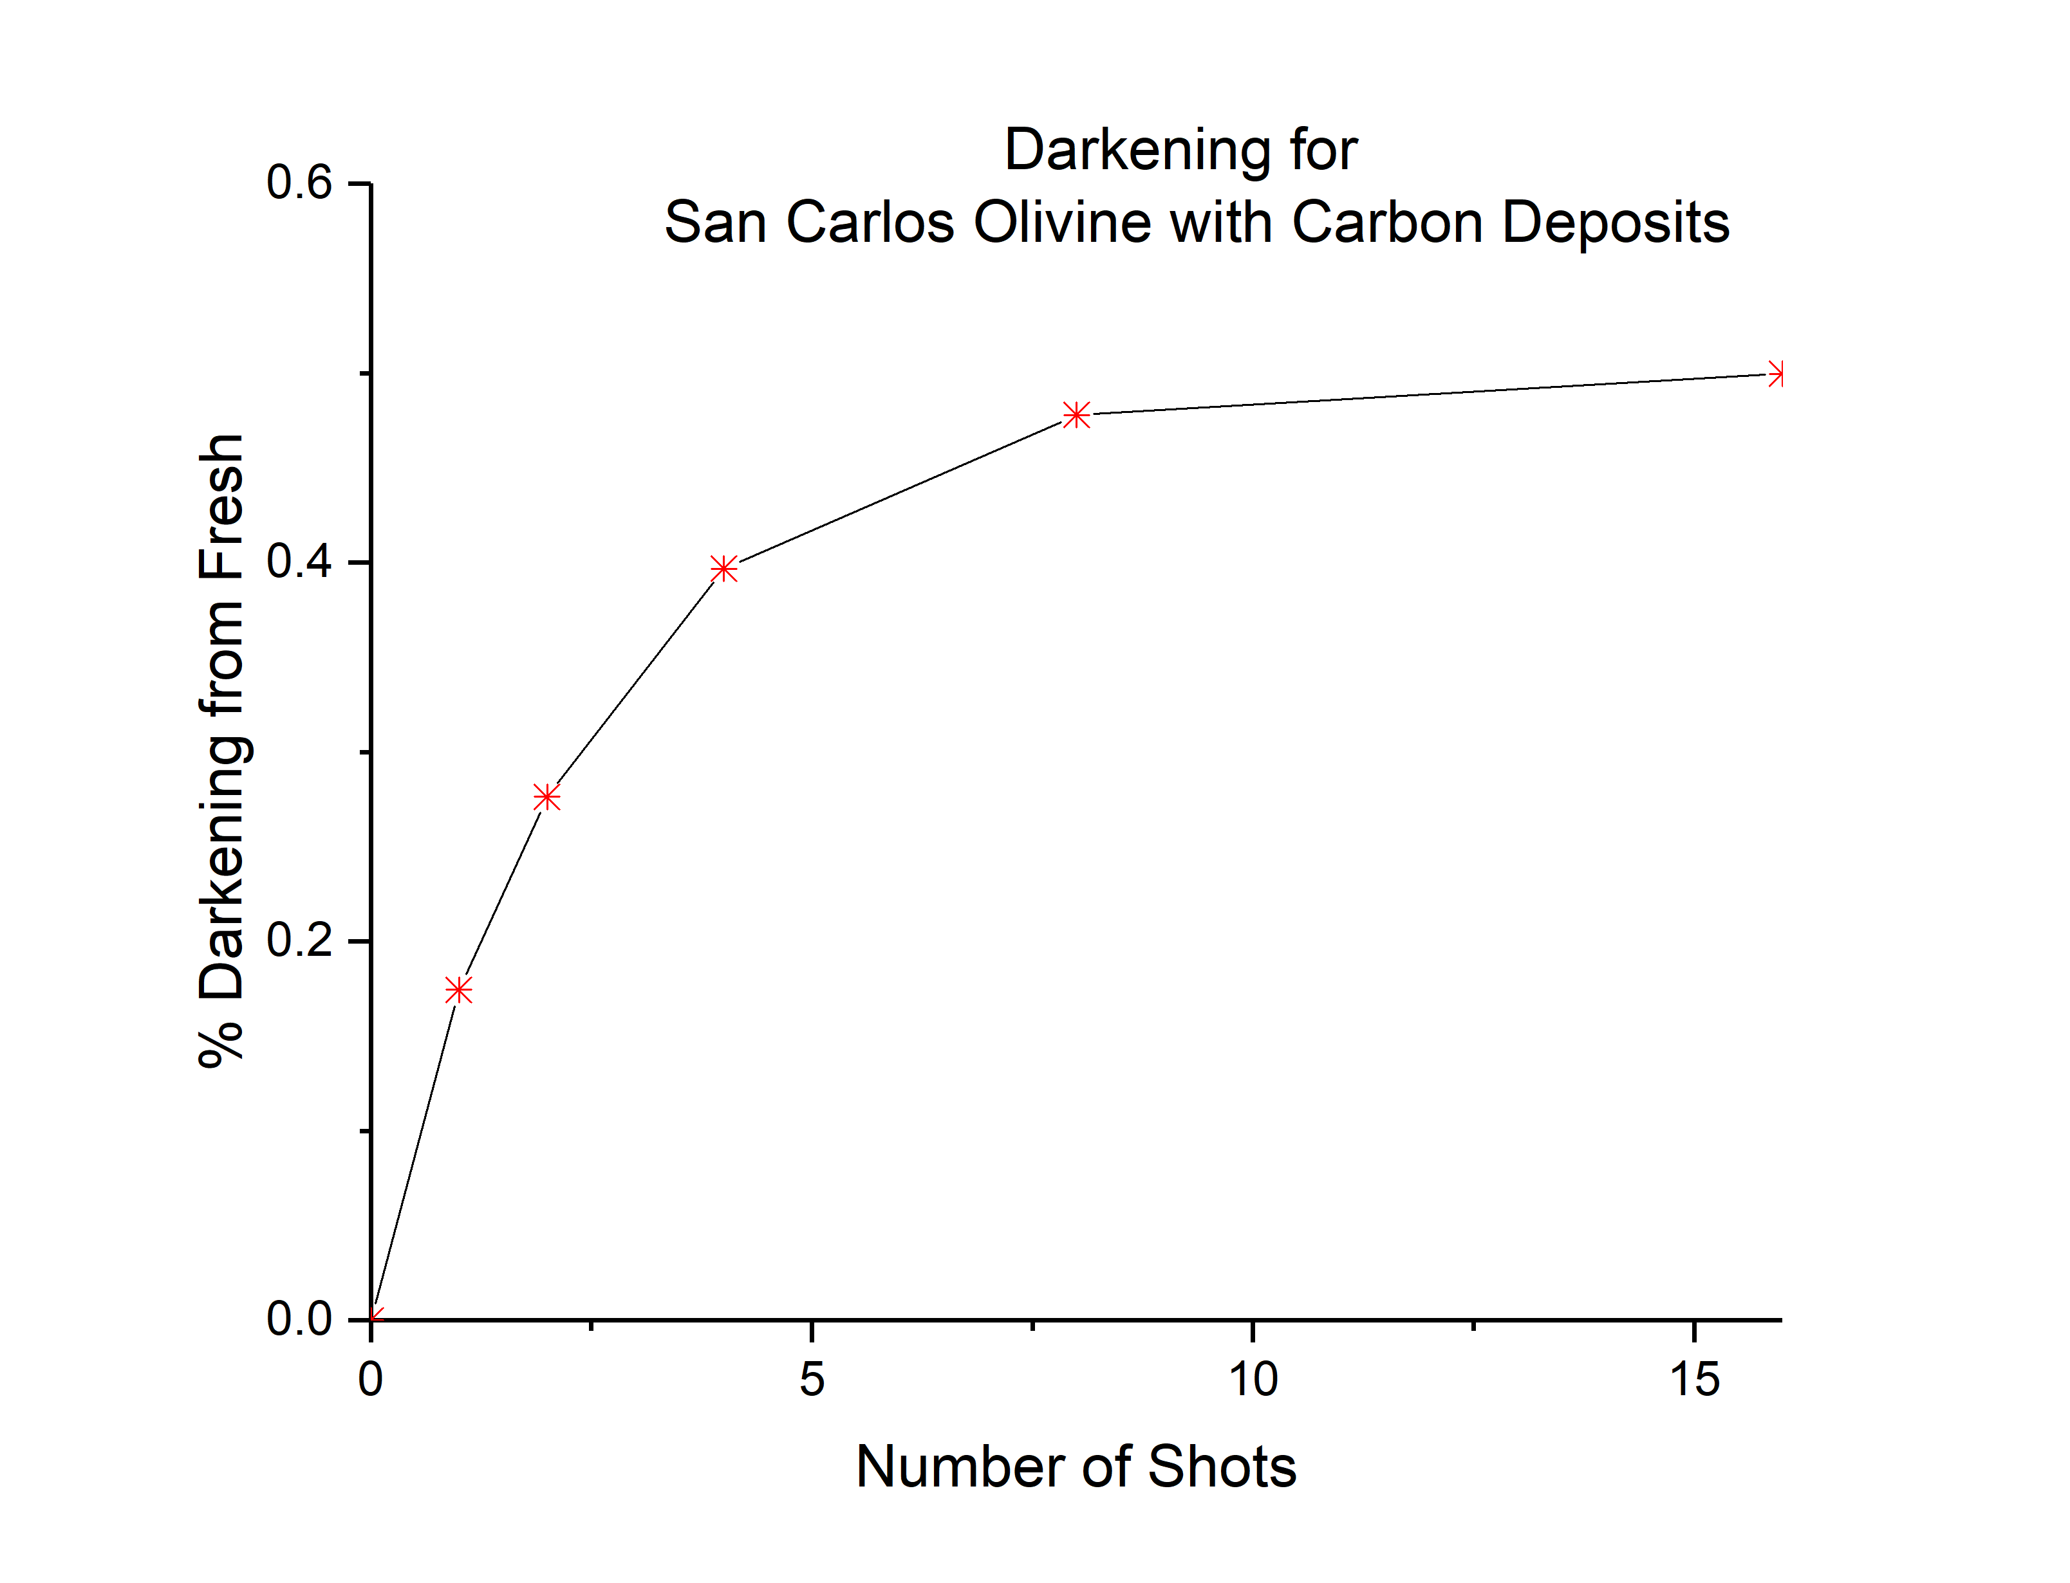
Spectral Darkening
50% darkening observed after 16 Shots at 2 microns.
This implies that thin carbon deposits substantially impact surface darkening on asteroids.

Slide 9
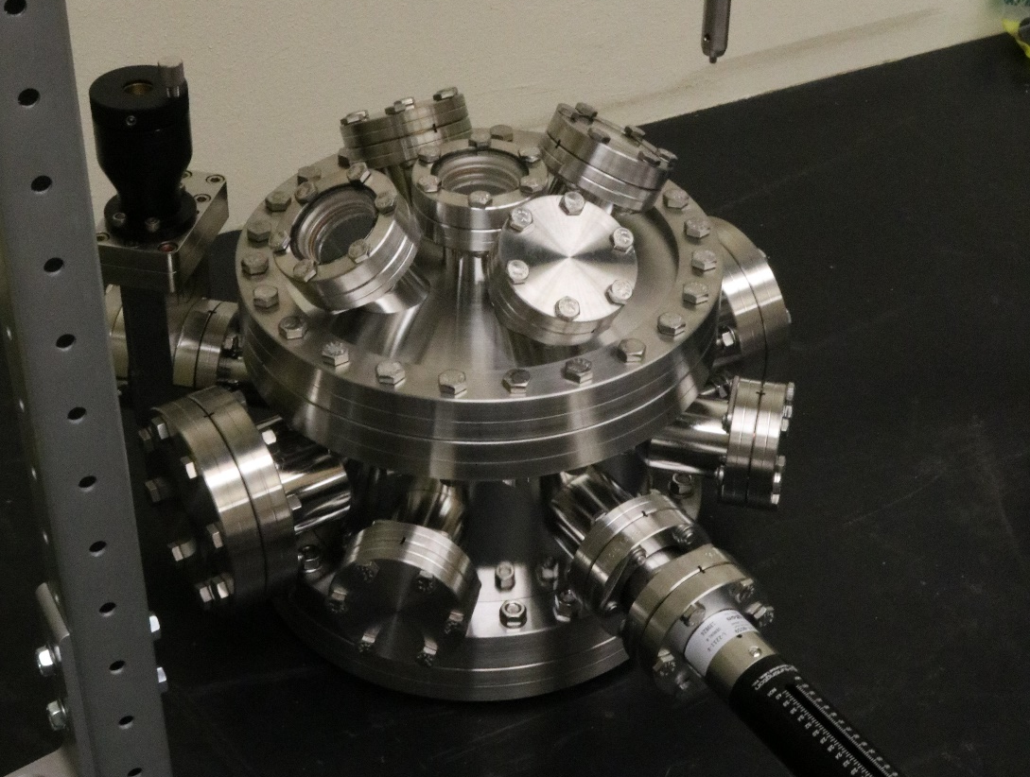
Future Prospects
Developing a system to analyze loose powdered mineral samples.
Studying the redeposition of kerogen-like materials.

Slide 10
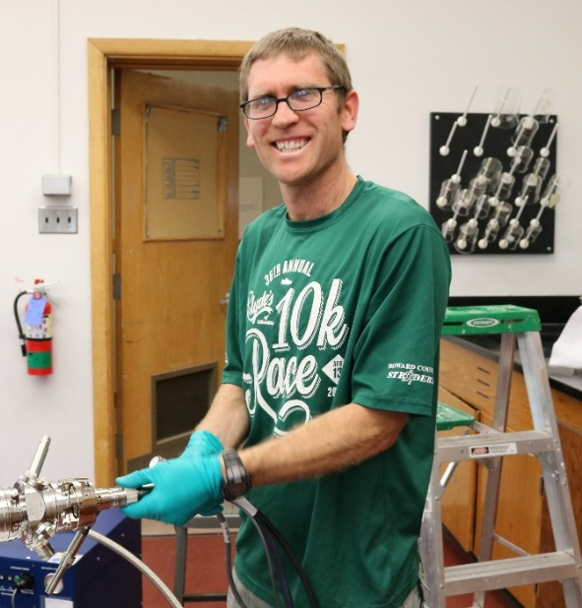
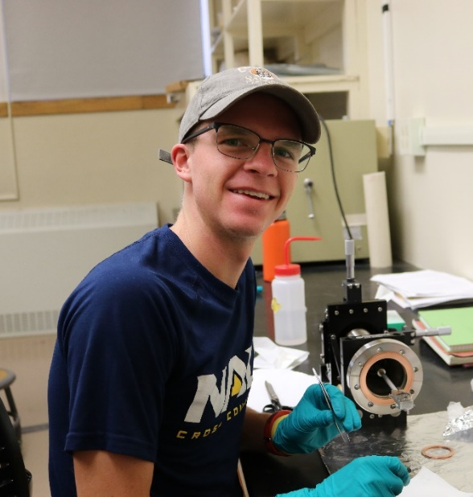


Acknowledgements
PEAXS Research Laboratory (NAU)
NAU NASA Space Grant Office
Dr. Mark Loeffler (Mentor)
Beau Prince (Lab Partner)
Dr. Nadine Barlow
Kathleen Stigmon

